Slide 1





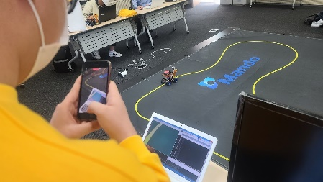
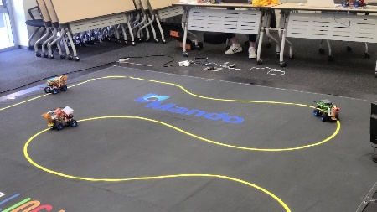
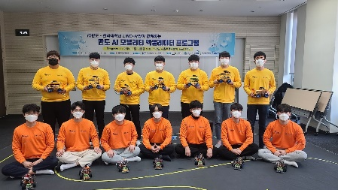
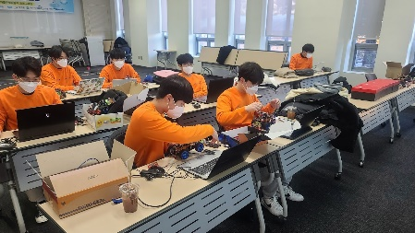

Slide 2
만도 자율주행 경진대회 프로그래밍 교육
Class 8
아두이노 모터 제어

Slide 3

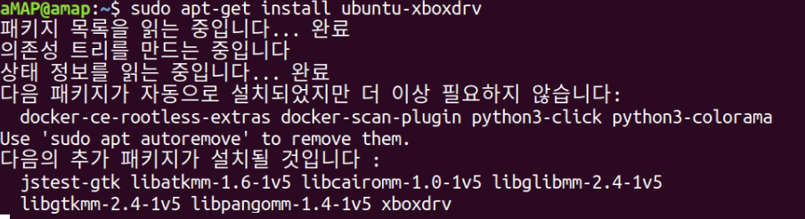
1. ROS(Robot Operating System) – Joystick module(wireless Xbox360) package 설치
sudo add-apt-repository ppa:mdeguzis/libregeek -> ubuntu 18.04 only
sudo apt-get update
sudo apt-get install xboxdrv - > RP4 unbuntu 18.04
sudo systemctl enable xboxdrv.service

Slide 4
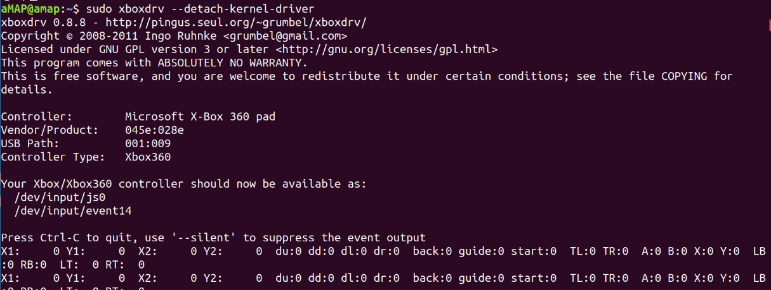
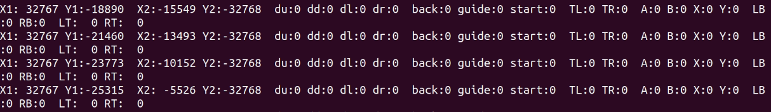
1. ROS(Robot Operating System) – Joystick module(wireless Xbox360) package 설치
sudo systemctl start xboxdrv.service
sudo xboxdrv --detach-kernel-driver
조이스틱을 움직여 작동 확인함

Slide 5

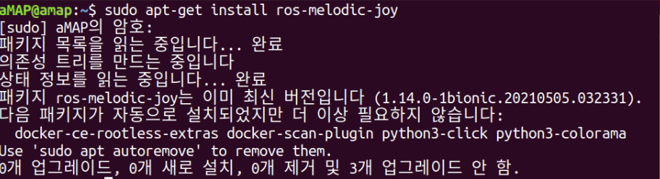
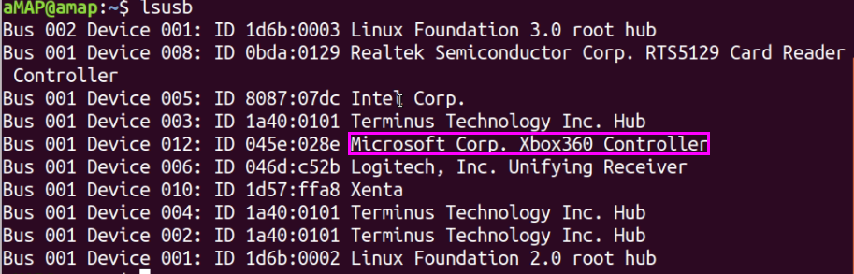
2. ROS(Robot Operating System) – Ros Joystick package 설치
sudo apt-get install ros-melodic-joy
Xbox360 무선 드라이버 설치 – USB 동글 연결 후 ls /dev/input/

Slide 6
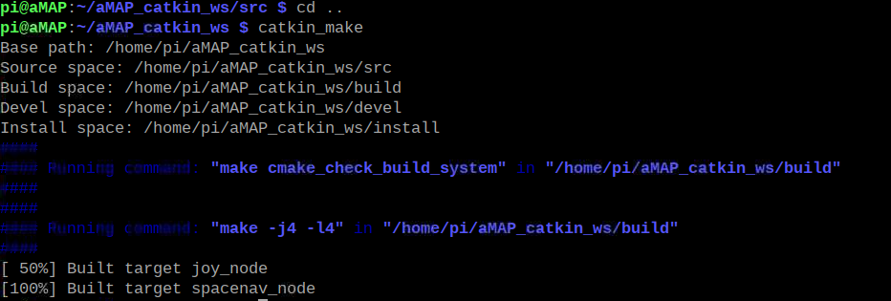
2. ROS(Robot Operating System) – Ros Joystick package 설치
sudo git clone https://github.com/ros-drivers/joystick_drivers.git
catkin_make
참고: https://ubunlog.com/ko/como-instalar-el-control-de-xbox-360-en-ubuntu-y-derivados/

Slide 7




2. ROS(Robot Operating System) – Ros Joystick package 설치
rospack find joy
ls /dev/input -> js0 가 없을 경우 reboot
sudo chmod a+rw /dev/input/js0
sudo jstest /dev/input/js0

Slide 8
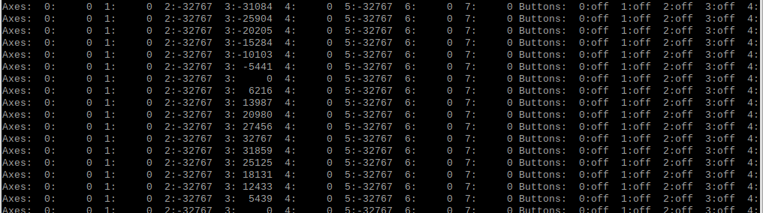
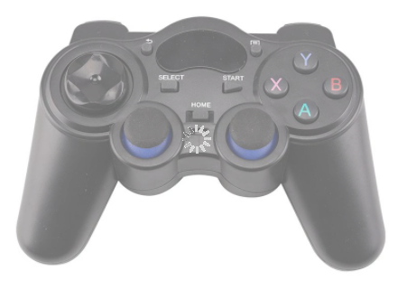
2. ROS(Robot Operating System) – Ros Joystick package 설치
Joy stick 작동 번호 확인

Slide 9
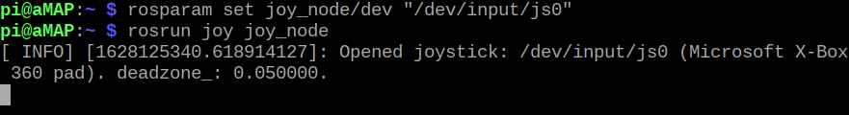
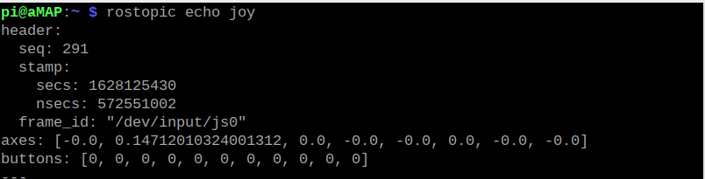
3. ROS(Robot Operating System) – Ros Joystick package 작동 확인
rospack find joy
rosparam set joy_node/dev "/dev/input/js0“
rosrun joy joy_node
rostopic echo joy

Slide 10
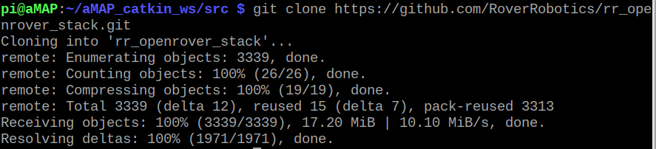
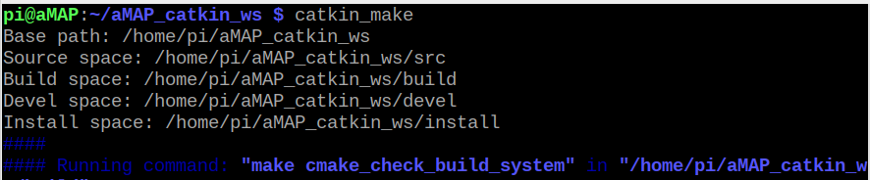
4. ROS(Robot Operating System) – joystick 을 이용한 cmd_vel_package 설치
git clone https://github.com/RoverRobotics/rr_openrover_stack.git
catkin_make

Slide 11
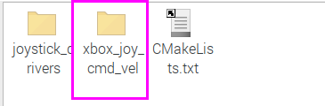
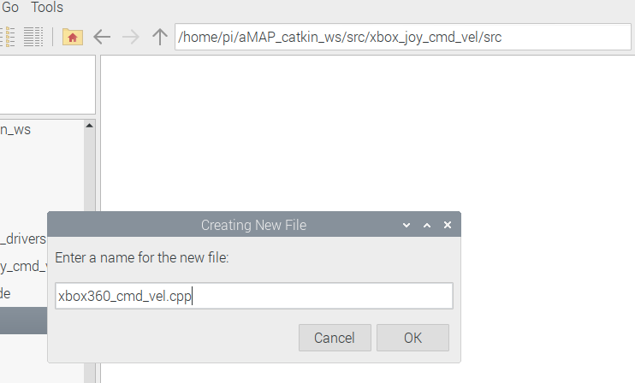
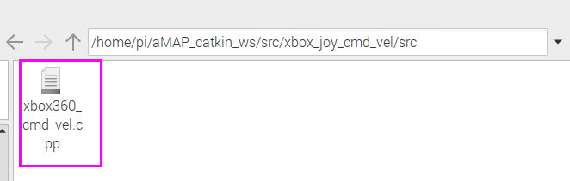
4. ROS(Robot Operating System) – joystick 을 이용한 xbox_joy_cmd_vel package 만들기
catkin_create_pkg xbox_joy_cmd_vel roscpp geometry_msgs sensor_msgs

Slide 12
4. ROS(Robot Operating System) – joystick 을 이용한 xbox_joy_cmd_vel package 만들기
#include <ros/ros.h>
#include <geometry_msgs/Twist.h>
#include <sensor_msgs/Joy.h>
// create the TeleopTurtle class and define the joyCallback function that will take a joy msg
class TeleopTurtle
{
public:
TeleopTurtle();
private:
void joyCallback(const sensor_msgs::Joy::ConstPtr& joy);
ros::NodeHandle nh_;
int linear_, angular_; // used to define which axes of the joystick will control our turtle
int l_scale_adj_, a_scale_adj_;
double l_scale_, a_scale_;
double max_linear_, max_angular_;
ros::Publisher vel_pub_;
ros::Subscriber joy_sub_;
};

Slide 13
4. ROS(Robot Operating System) – joystick 을 이용한 xbox_joy_cmd_vel package 만들기
TeleopTurtle::TeleopTurtle(): linear_(1), angular_(3), l_scale_(2), a_scale_(0.5), max_linear_(4), max_angular_(3.1415)
{
// initialize some parameters
nh_.param("axis_linear", linear_, linear_);
nh_.param("axis_angular", angular_, angular_);
nh_.param("max_linear", max_linear_, max_linear_);
nh_.param("max_angular", max_angular_, max_angular_);
nh_.param("scale_angular", a_scale_, a_scale_);
nh_.param("scale_linear", l_scale_, l_scale_);
nh_.param("scale_angular_adj", a_scale_adj_, a_scale_adj_); // angular scale change
nh_.param("scale_linear_adj", l_scale_adj_, l_scale_adj_); // linear scale change
// create a publisher that will advertise on the command_velocity topic of the turtle
vel_pub_ = nh_.advertise<geometry_msgs::Twist>("/cmd_vel/xbox360", 1);
// subscribe to the joystick topic for the input to drive the turtle
joy_sub_ = nh_.subscribe<sensor_msgs::Joy>("joy", 10, &TeleopTurtle::joyCallback, this);
}

Slide 14
4. ROS(Robot Operating System) – joystick 을 이용한 xbox_joy_cmd_vel package 만들기
void TeleopTurtle::joyCallback(const sensor_msgs::Joy::ConstPtr& joy)
{
geometry_msgs::Twist twist;
// take the data from the joystick and manipulate it by scaling it and using independent axes to control the linear and angular velocities of the turtle
l_scale_ += 0.1*joy->axes[l_scale_adj_];
a_scale_ -= 0.01*joy->axes[a_scale_adj_]; twist.angular.z = a_scale_*joy->axes[angular_];
twist.linear.x = l_scale_*joy->axes[linear_];
a_scale_ = (a_scale_>= max_angular_) ? max_angular_ : a_scale_;
a_scale_ = (a_scale_ <= 0.01) ? 0.01 : a_scale_;
l_scale_ = (l_scale_ >= max_linear_) ? max_linear_ : l_scale_;
l_scale_ = (l_scale_ <= 0.1) ? 0.1 : l_scale_;
/*
for(int i=0;i<8;i++)
{
printf("%d %6.3lf \n",i,joy->axes[i]); // 채널 확인용
}
*/
//printf("%6.5lf %6.5lf %6.5lf %6.5lf \n",l_scale_,a_scale_, twist.linear.x , twist.angular.z );
vel_pub_.publish(twist);
}
(int argc, char** argv)
{
// initialize our ROS node, create a teleop_turtle, and spin our node
until Ctrl-C is pressed
ros::init(argc, argv, "teleop_turtle");
TeleopTurtle teleop_turtle;
ros::spin();
}

Slide 15
4. ROS(Robot Operating System) – joystick 을 이용한 xbox_joy_cmd_vel package 만들기
CMakeLists.txt 편집
cmake_minimum_required(VERSION 3.0.2)
project(xbox_joy_cmd_vel)
## Compile as C++11, supported in ROS Kinetic and newer
# add_compile_options(-std=c++11)
## Find catkin macros and libraries
## if COMPONENTS list like find_package(catkin REQUIRED COMPONENTS xyz)
## is used, also find other catkin packages
find_package(catkin REQUIRED COMPONENTS
geometry_msgs
roscpp
sensor_msgs
)
catkin_package(
INCLUDE_DIRS include
LIBRARIES xbox_joy_cmd_vel
CATKIN_DEPENDS geometry_msgs roscpp sensor_msgs
DEPENDS system_lib
)
###########
## Build ##
###########
## Specify additional locations of header files
## Your package locations should be listed before other locations
include_directories(
# include
${catkin_INCLUDE_DIRS}
)
add_executable(xbox_joy_cmd_vel_node src/xbox360_cmd_vel.cpp)
target_link_libraries(xbox_joy_cmd_vel_node ${catkin_LIBRARIES})

Slide 16
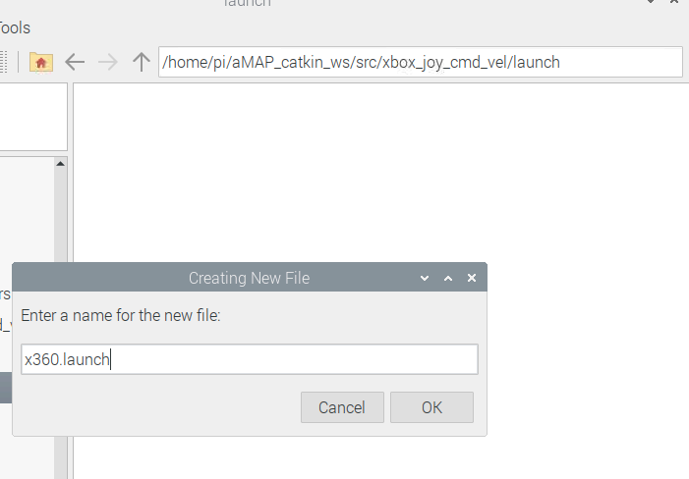
4. ROS(Robot Operating System) – joystick 을 이용한 xbox_joy_cmd_vel package 만들기
launch 파일 작성
스케일 초기값
<launch>
<!-- joy node -->
<node respawn="true" pkg="joy"
type="joy_node" name="ros_joy" >
<param name="dev" type="string" value="/dev/input/js0" />
<param name="deadzone" value="0.12" />
</node>
<!-- Axes -->
<param name="axis_linear" value="1" type="int"/>
<param name="axis_angular" value="3" type="int"/>
<param name="scale_linear_adj" value="7" type="int"/>
<param name="scale_angular_adj" value=“6" type="int"/>
<param name="max_linear" value="4" type="double"/>
<param name="max_angular" value="3.14158" type="double"/>
<param name="scale_linear" value=“1" type="double"/>
<param name="scale_angular" value=“0.5" type="double"/>
<node pkg="xbox_joy_cmd_vel" type="xbox_joy_cmd_vel_node" name="teleop_x360"/>
</launch>
붉은색 채널 확인해서 수정할 것

Slide 17
4. ROS(Robot Operating System) – joystick 을 이용한 xbox_joy_cmd_vel package 만들기
6,7 번 스케일 조정
7
6
3
1
1,3 번 전진, 회전

Slide 18
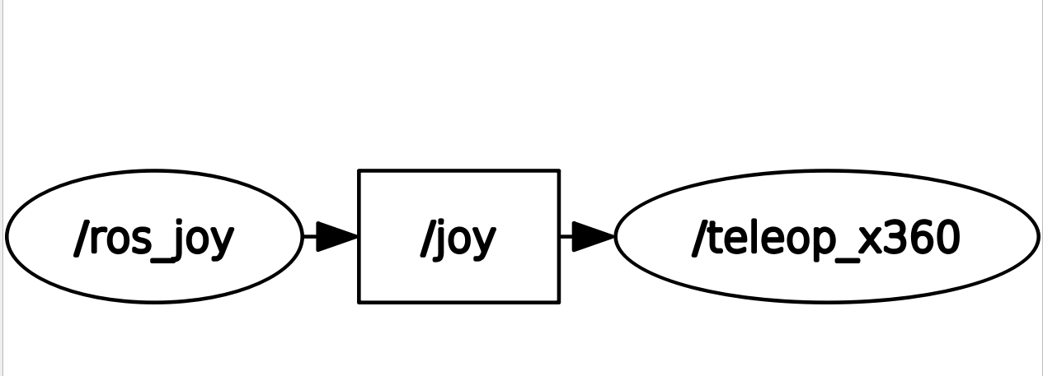
5. ROS(Robot Operating System) – rqt_graph
rqt_graph

Slide 19
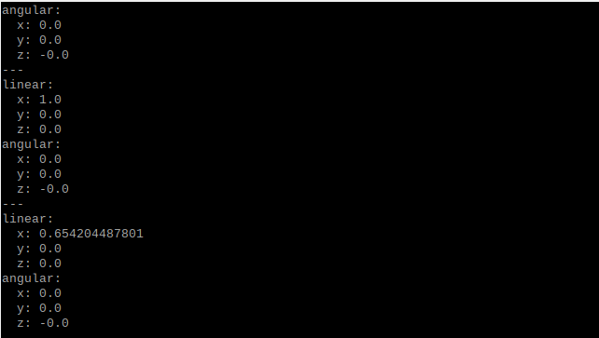
6. ROS(Robot Operating System) – 실행 결과
rostopic echo /cmd_vel/xbox360

